Slide 1
alibi
Your financial passport
Your money’s alibi, ready before anyone asks.
REPO LINK: https://github.com/eliohd/winthrutheory-eceb0cdd-submission-repo
DEMO LINK: https://www.alibi-app.workers.dev/

Slide 2
alibi
/ˈæl.ɪ.baɪ/ noun
Proof of where your money came from, gathered before anyone asks, and shared only with the people you choose.
“Maya’s alibi was ready before her bank even asked.”

Slide 3

Meet Maya. Her bank restricted her account, and rent is due.
A student who resells her old clothes online to cover rent.
“I sold clothes. That’s it. But how do I prove it without handing my bank my whole life?”
What happened
Using alibi,
A monthly payout of £2,160 from her reselling side-hustle. Her bank restricted the account and asked where it came from.
Maya approves which records to share. The bank analyst decides separately: clear, escalate or ask for more.

Slide 4








Gemini investigates. Code decides. Maya approves.
RFC
Bank A asks “Explain the £2,160 credit”
01 Connect
02 Remember
03 Investigate
04 Approve
05 Verify
Merchants
alibi passport
alibi engine
Reasoning with
Bank A gets
✓
Signed package
Ed25519
Living financial passport
reads
SHARED
Tool gateway
Scoped, budgeted reads. Text never instructs.
✓ £2,160 credit
✓ Payout PO-0001-01
✓ 18 signed records
Bank A analyst
Matcher
3.8 Flash
Detective
3.8 Flash
✓ Every signature checked
Owned by Maya
Versioned: nothing is overwritten
Encrypted at rest
Links payouts to credits
Spots what’s missing
KEPT PRIVATE
signed records
+£2,160 → PO-0001-01
£2,160 unexplained
Rent
Two card payments
An eyewear purchase
Clear
Escalate
Ask for more
Her banks
Challenger
4 Argon
Curator
3.8 Flash
Fetches the proof
Picks minimal evidence
Release ≠ transfer
3 shared · 3 private
draft
privacy rules
“Never share my rent” becomes an enforced rule.
Bank B
Trust, per record
Gemma cross-checks Matcher and Detective
issuer_verified
Asks next. Same passport, fresh consent, no access to Bank A’s package.
bank_observed
Code decides
Checks every reference and penny. Traces every claim.
read-only feed
self_supplied
240000 − 18000 − 6000 = 216000
✓ supported
Approve exactly this

Slide 5
The evidence was already there
alibi builds Maya’s history in the background, from marketplace and bank connections, before any bank asks.
merchant records
bank feed
!
?
5–14 OCT
26 OCT
27 OCT
28 OCT
BEFORE ANY REQUEST
2 NOV
8 sales, 2 refunds, 8 fees, each signed
Released to seller balance
Payout PO-0001-01 settles
£2,160 credit lands
Flagged as unexplained
Bank A asks for Maya’s evidence
£2,400
£180
£60
£2,160
−
−
=
8 sales
2 refunds
8 fees
the credit
✓ Reconciled in code from 18 signed records: 240000 − 18000 − 6000 = 216000 pence

Slide 6
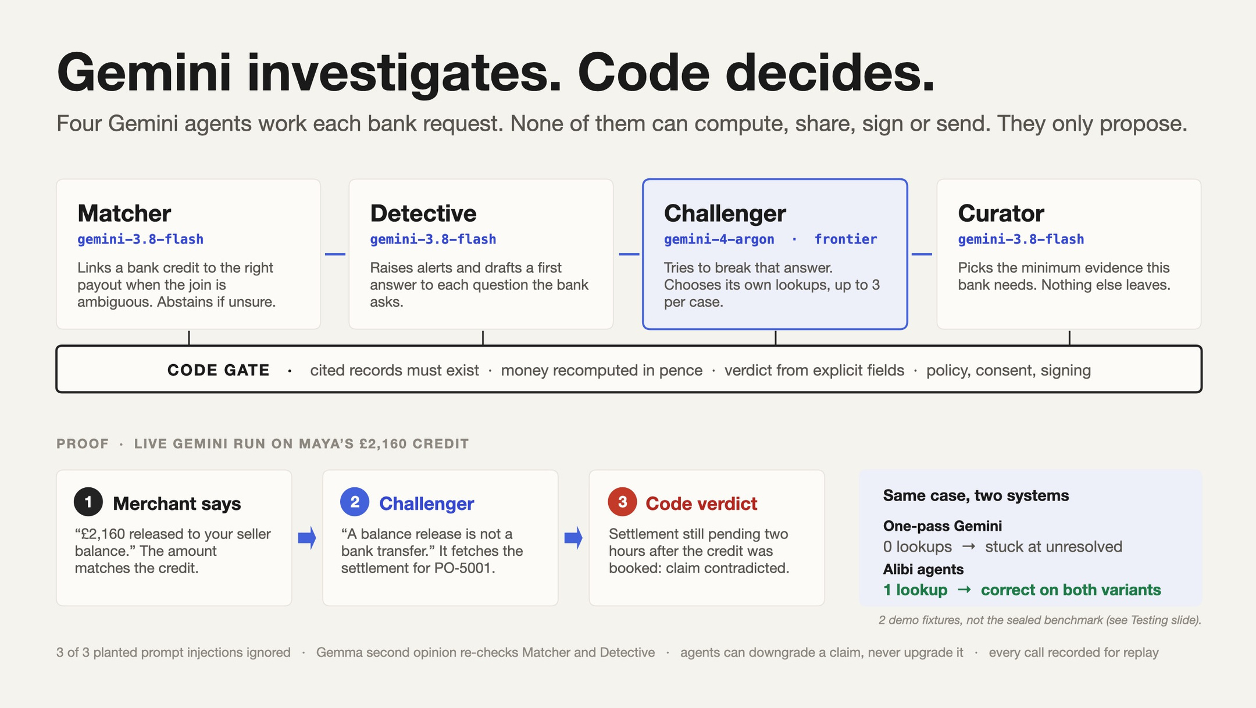
Matching amounts are not proof
From a live Gemini run on Maya’s £2,160 credit.
1
Merchant says
2
Challenger
4 Argon
3
Code verdict
“£2,160 released to your seller balance.”
“A balance release is not a bank transfer.”
Settlement still pending two hours after the credit was booked.
The amount matches the credit.
It fetches the PO-5001 settlement.
claim contradicted

Slide 7
Maya sees exactly what the bank will see
Code builds the smallest package that answers the question. Nothing leaves until Maya approves it.
alibi
Bank A
1
Built by code, not the model
Share with Bank A
Gemini proposes the evidence. Code filters it against Maya’s rules, and deny wins.
INCLUDED
✓ The £2,160 credit
✓ Payout PO-0001-01
✓ 18 sale, refund and fee records
2
Approval covers this exact package
It is bound to these contents, Bank A and this request. Any edit voids it.
STAYS PRIVATE
Rent
Two card payments
An eyewear purchase
3
Private records stay out
Rent and personal purchases are excluded from every package.
Approve and send

Slide 8
Bank B asks next. Maya doesn’t start over.
Both questions are answered from one persisted passport.
Bank A
alibi passport
Bank B
Where did the £2,160 come from?
What were her marketplace sales and refunds, 1 Oct to 1 Nov?
Same passport
Same source records
No re-import
£2,160
PO-0001-01
£2,400
£180
the credit
payout
8 sales
2 refunds
Package 1 · Maya approved
Package 2 · fresh approval
Reusing Bank A’s approval for Bank B
Bank A opening Bank B’s package
⊘
refused
⊘
refused

Slide 9
What we measured, and where it stops
We built on data we could see. Then we scored on data we had never seen.
SEEN
73 / 80
UNSEEN
19 / 44
What we built and tuned on
What we never saw while building
Limits
1
2
3
4
Synthetic records and simulated bank and marketplace services only
Monitoring is not anti-money-laundering screening or scam detection
A signature proves a package wasn’t altered, not that its claims are true
Whether a real bank would accept these packages is unmeasured

Slide 10
Evidence that is ready.
Disclosure that is chosen.
Maya proved where her money came from, shared only what she chose, and gave the analyst what they needed to decide, in a fraction of the time.
alibi
/ˈæl.ɪ.baɪ/ noun · proof of where your money came from, gathered before anyone asks
REPO LINK: https://github.com/eliohd/winthrutheory-eceb0cdd-submission-repo
DEMO LINK: https://www.alibi-app.workers.dev/

